Slide 1

OSI Model

Slide 2
Introduction
OSI stands for Open System Interconnection. It has been developed by ISO- ‘International Organization of Standardization’, in the year 1984.
Designed to show the flow of moving data from one software application of one computer to another software application of another computer.
Open System Interconnection (OSI) model is the virtual model which describes the concept of a computer system with the concern of internal structure and technology.

Slide 3
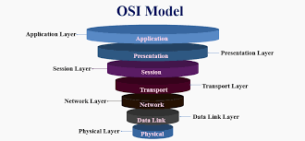
OSI Model Layer
Physical Layer
Data Link Layer
Network Layer
Transport Layer
Session Layer
Presentation Layer
Application Layer

Slide 4
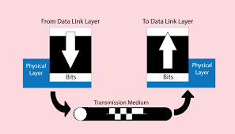
Physical Layer
The functions of the physical layer are:
Bit Synchronization: The physical layer provides the synchronization of the bits by providing a clock.
Bit rate control: The Physical layer also defines the transmission rate i.e. the number of bits sent per second.
Physical topologies: Physical layer specifies the way in which the different, devices/nodes are arranged in a network i.e. bus, star or mesh topology.

Slide 5
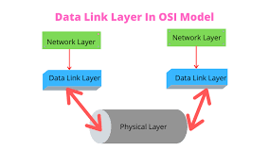
Data Link Layer
The data link layer is responsible for the node to node delivery of the message.
Packet in Data Link Layer is referred as Frame.
Data Link Layer is handled by the NIC (Network Interface Card) and device drivers of host machines.
Switch and Bridge are Data Link Layer devices.

Slide 6
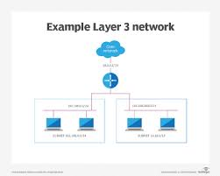
Network Layer
Routing: The network layer protocols determine which route is suitable from source to destination. This function of network layer is known as routing.
Logical Addressing: In order to identify each device on internetwork uniquely, network layer defines an addressing scheme.
Segment in Network layer is referred as Packet.

Slide 7
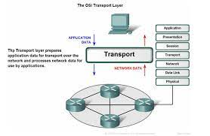
Transport Layer
Segmentation and Reassembly: This layer accepts the message from the (session) layer, breaks the message into smaller units.
Service Point Addressing: In order to deliver the message to correct process. Transport layer header includes a type of address called service point address or port address.
Connection Less Service: It is a one-phase process and includes Data Transfer.

Slide 8
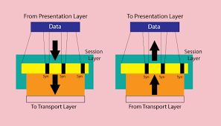
Session Layer
Session establishment, maintenance and termination: The layer allows the two processes to establish, use and terminate a connection.
Synchronization: This layer allows a process to add checkpoints which are considered as synchronization points into the data. These synchronization point help to identify the error so that the data is re-synchronized properly, and ends of the messages are not cut prematurely and data loss is avoided.

Slide 9
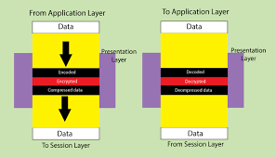
Presentation Layer
Translation: For example, ASCII to EBCDIC.
Encryption/ Decryption: Data encryption translates the data into another form or code. The encrypted data is known as the cipher text and the decrypted data is known as plain text. A key value is used for encrypting as well as decrypting data.
Compression: Reduces the number of bits that need to be transmitted on the network.

Slide 10
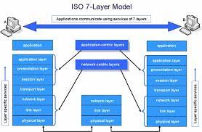
Application Layer
At the very top of the OSI Reference Model stack of layers, we find Application layer which is implemented by the network applications. These applications produce the data, which has to be transferred over the network. This layer also serves as a window for the application services to access the network and for displaying the received information to the user.

Slide 11
THANK YOU

